Slide 1
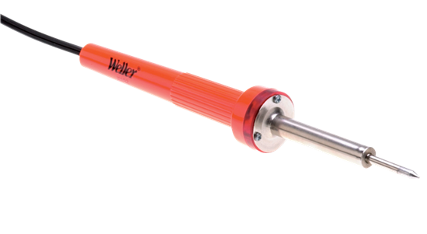
Scintilla Soldering Course
16 September 2025

Slide 2
Planning
Lecture
Practical
What is soldering?
Electronic components
Soldering techniques
Finding and fixing errors
Principles of the kit
Planning your lay-out
Assembling your lay-out
Soldering the components
Testing
Debugging
Testing
Etc.

Slide 3
What is soldering?
Breadboard
Soldering
For testing
Temporary
Fragile
Not suitable for high frequencies
Permanent
Rigid and proper electrical connections
Durable

Slide 4
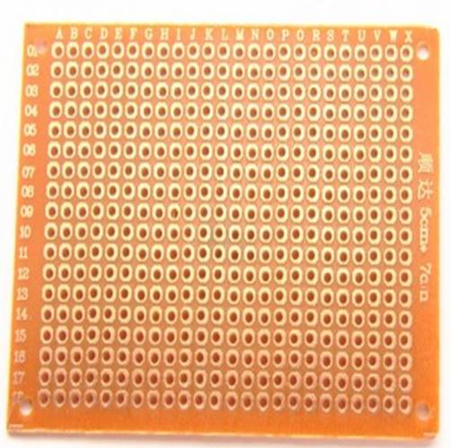
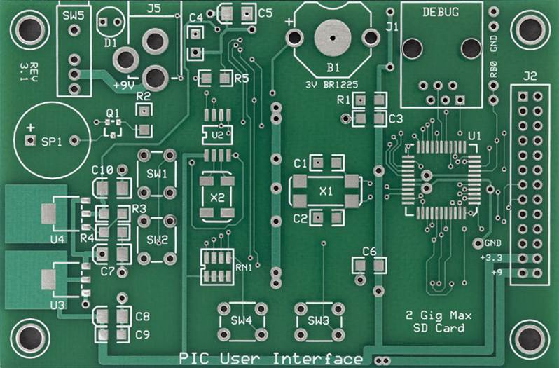
What is soldering?
Through-hole (THT)
Surface mount (SMD)

Slide 5
Electronic Components
What to take into account?

Slide 6
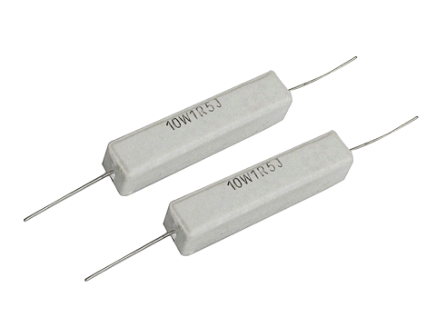
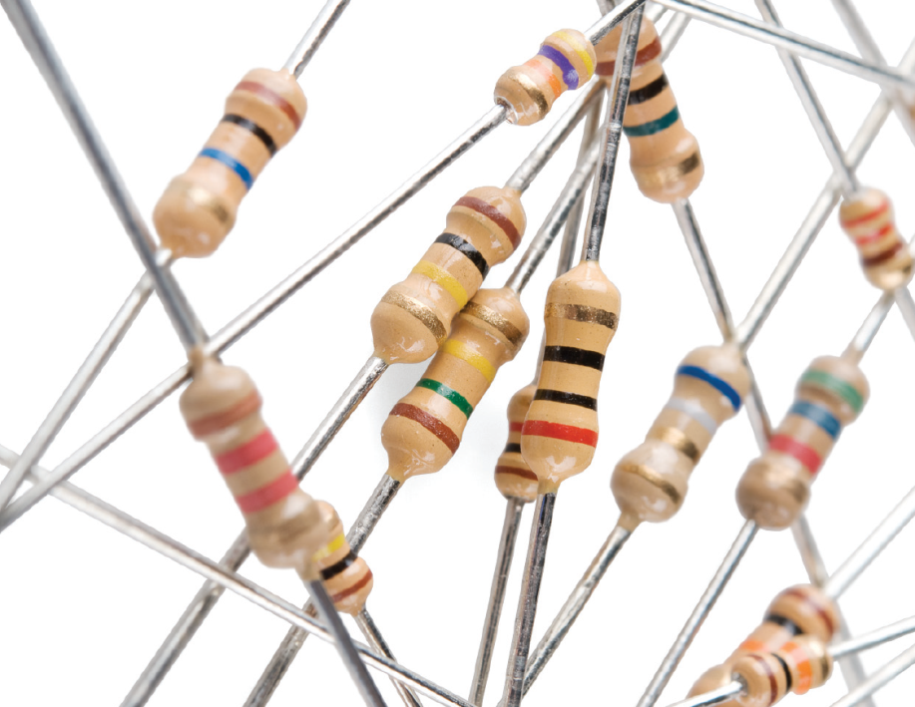
Resistors

Slide 7
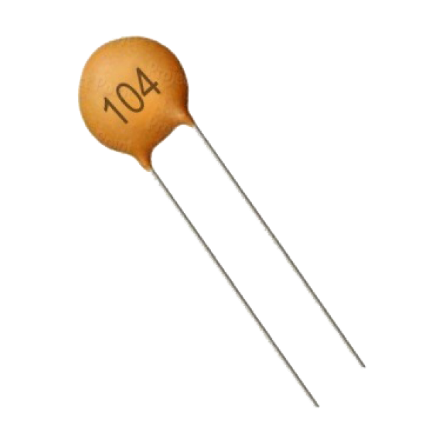
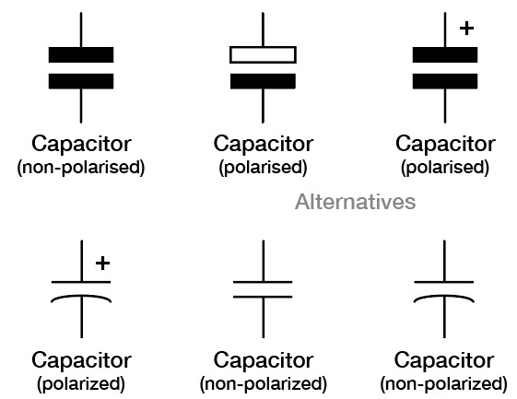
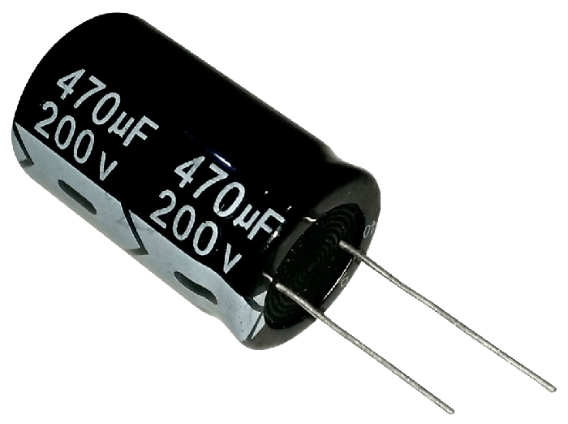
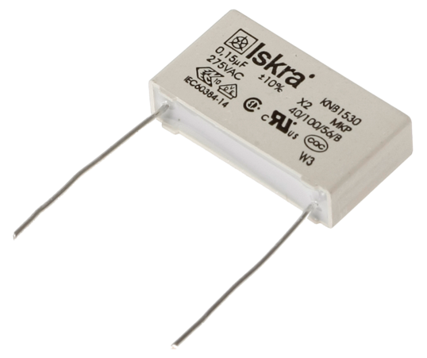
Capacitors

Slide 8
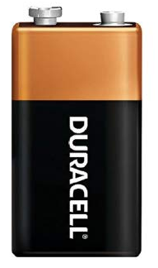
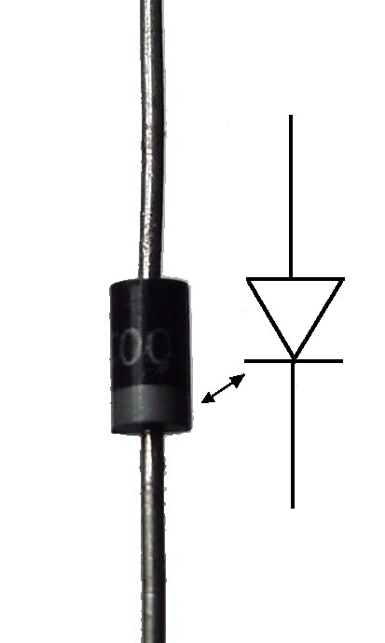
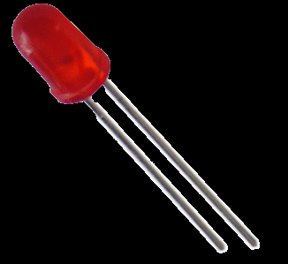
Polarized Components
-
+
Only possible to connect in 1 direction
+
Long side usually ‘+’
White stripe usually ‘-’
-
*Not sponsored
** Not affiliated to Duracell do-group
+
-

Slide 9
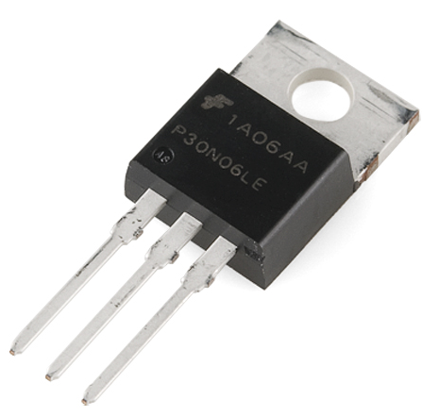
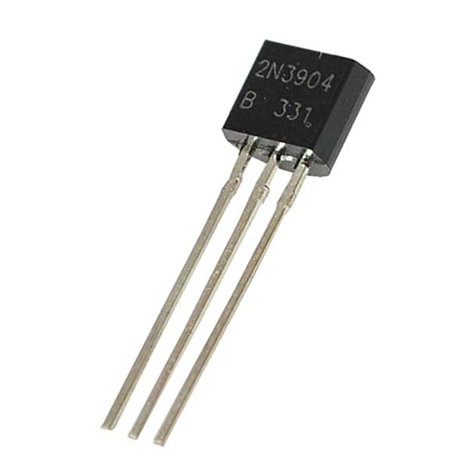
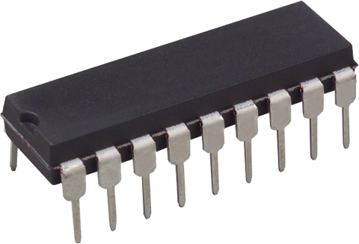
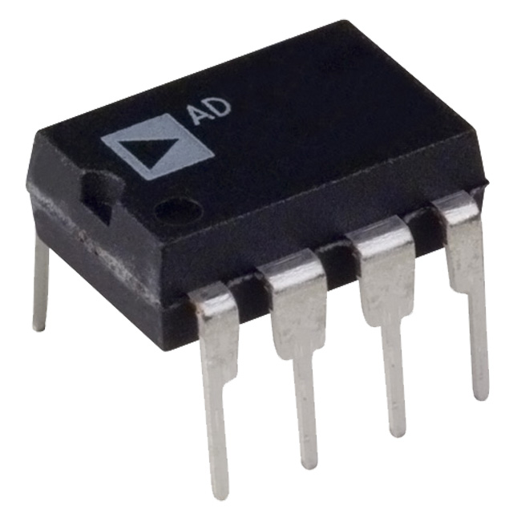
Help it has more pins!?

Slide 10
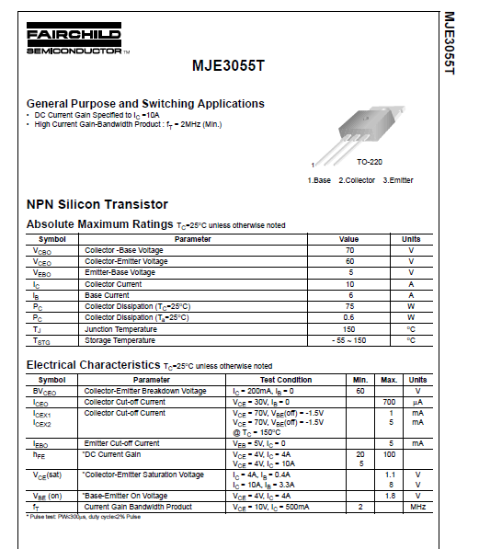
Reading Datasheets
What can you find?
Maximum ratings
Common applications
Electrical characteristics
Pin layout(!)

Slide 11
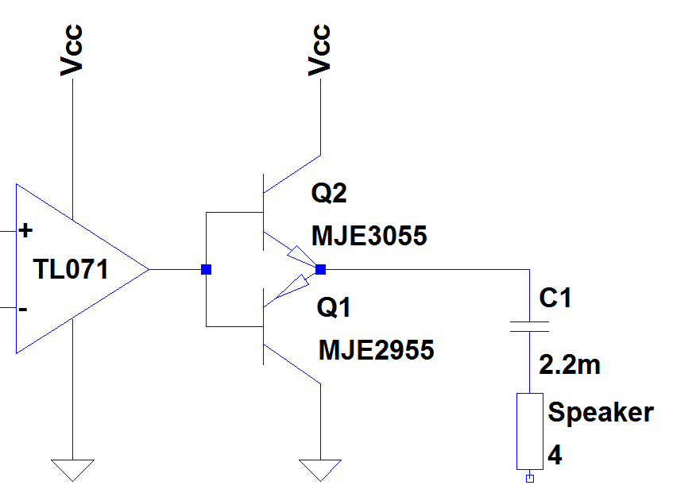
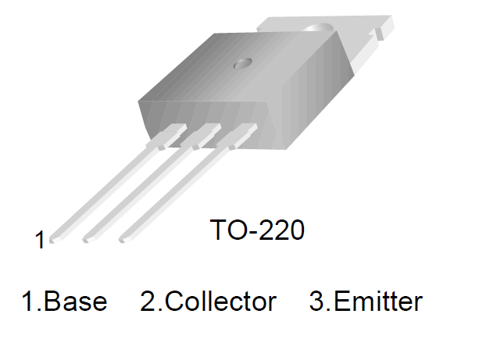
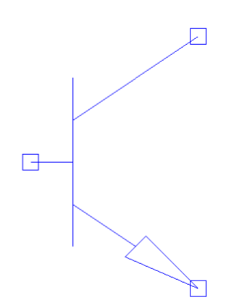
Transistor
Heat sink might be connected to one of the pins!
C
B
E

Slide 12
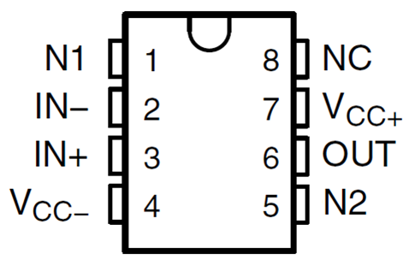
Op-Amp

Slide 13
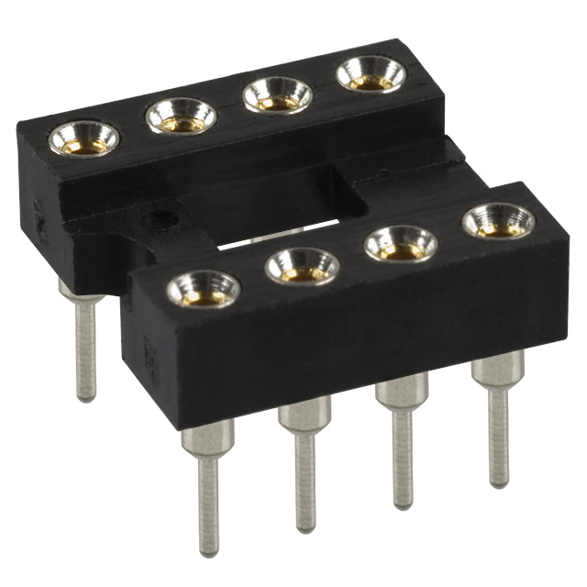
IC Sockets
What are they used for?
Easy to replace components
Prevents overheating during soldering

Slide 14
Soldering techniques
Do’s and don’ts

Slide 15
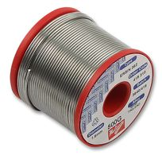
Sorts of tin
Unleaded solder ~330°C
  Has an expiration date
  Uses flux core
Leaded solder ~230°C
  Higher melting point
  Toxic fumes
  Easier to solder
Flux
  ‘Repairs’ oxidized metals

Slide 16
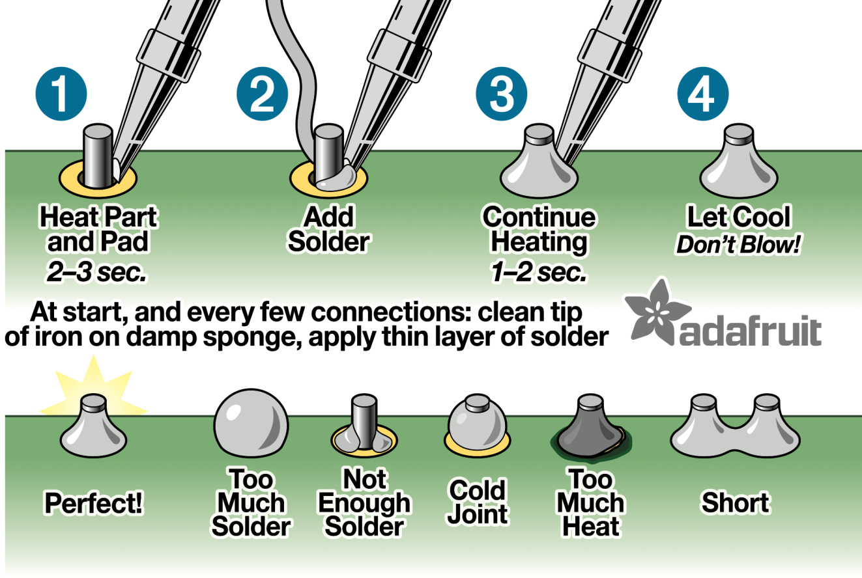
How to do it correctly

Slide 17
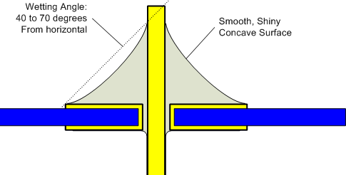
Correct Joint

Slide 18
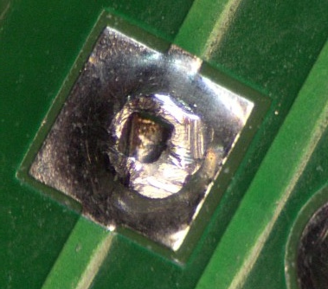
Cold Joint
Cause: cold metal
Solution: Reheat (and add new solder/flux)

Slide 19
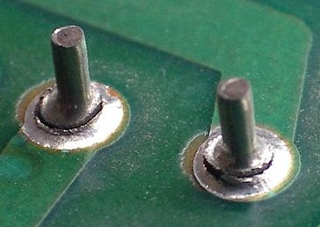
Dry Joint
Cause: Movement
during cooling
Solution: Reheat

Slide 20
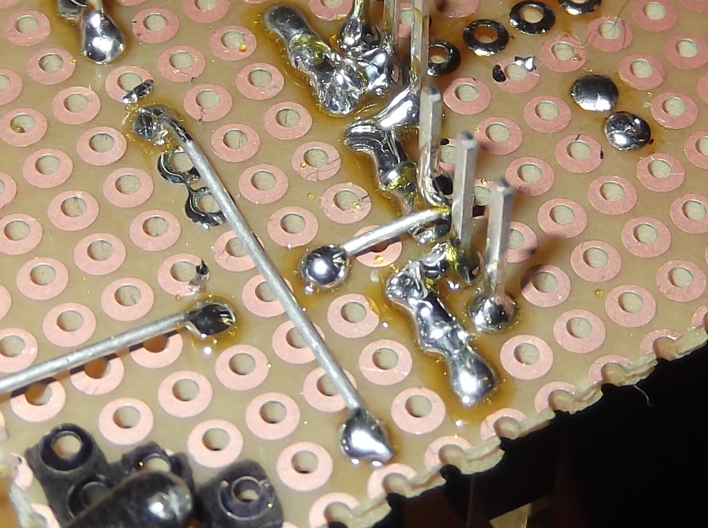
Connections
Using Component Legs
Saves effort and solder
Use the components to make a bridge

Slide 21
Connections
Using Solder Bridges
Connects nearby components
Use tin to make the connection

Slide 22
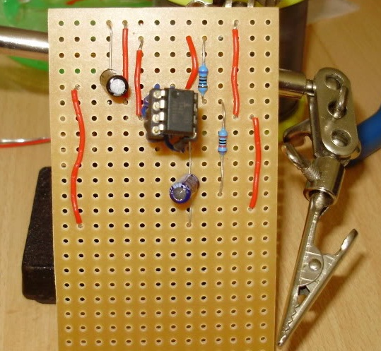
Connections
Using Wire Bridges
Covers large distances
Makes circuit chaotic
Try to avoid these!
Very BAD example!!!

Slide 23
Fitting Components
Keep it tidy!
Make sure components are flush with the PCB
Avoid using wires
Do not connect the IC until after soldering
Very BAD example!!!

Slide 24
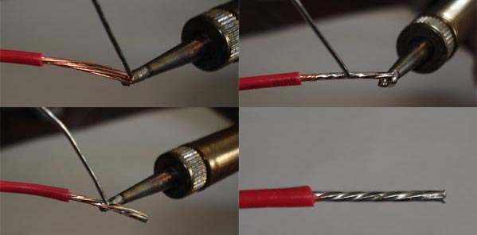
Soft Core Wires

Slide 25
Finding Errors
And fixing them!

Slide 26
Finding errors
Visual inspection
Voltage measurements at critical points
Follow the signal
Common errors:
  Missing connections
  Short circuits
  Cold joints
  Dry joints

Slide 27
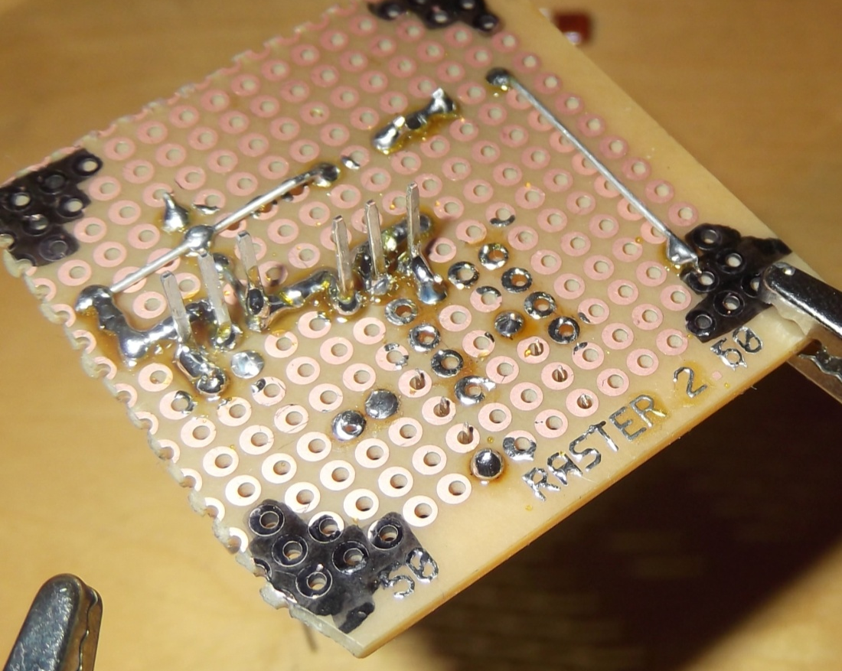
Visual Inspection
Clearly not finished
Fast and simple method to find faulty or missing connections

Slide 28
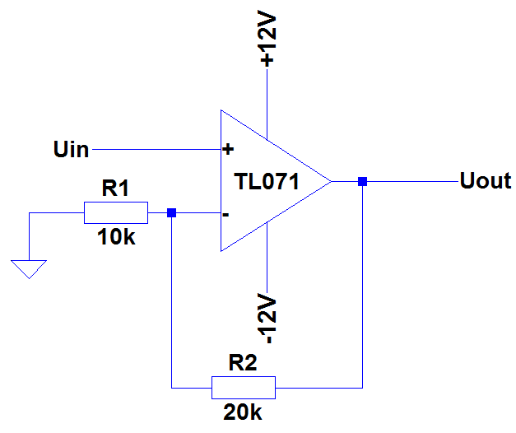
Voltage measurement
What voltages do you expect at every node?
Check DC first
Then follow the signal through the circuit

Slide 29

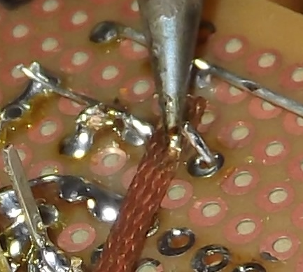
Fixing errors
Desoldering Pump
Desoldering Wick

Slide 30
Audio Amplifier

Slide 31
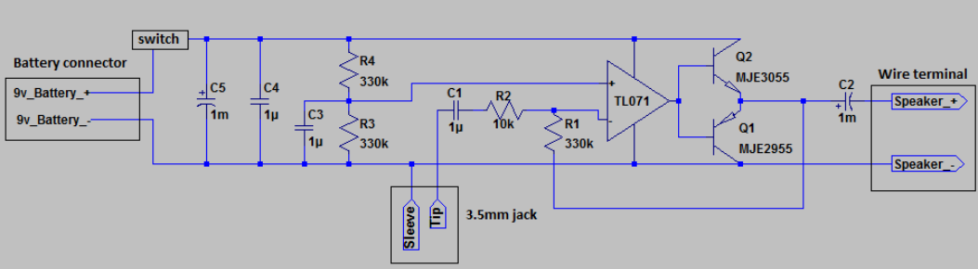
The Practical

Slide 32
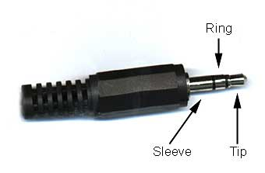
Jack Plug
Right channel
Mono amplifiers only
use the left channel
Ground
Left channel

Slide 33
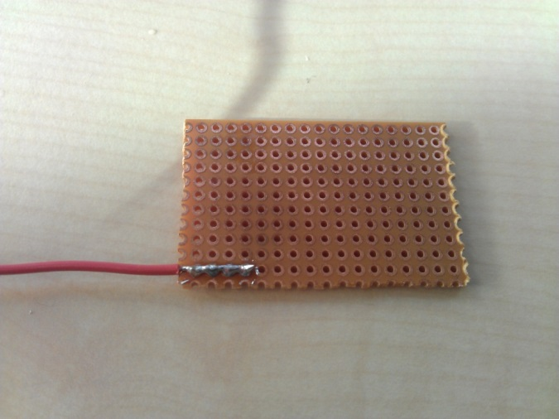
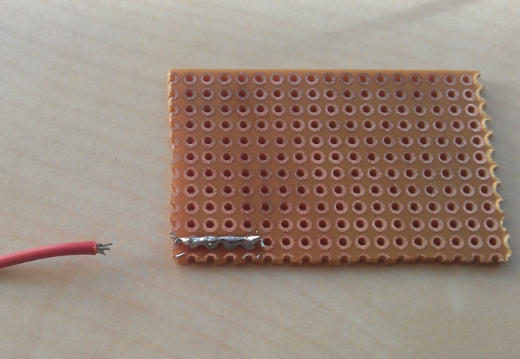
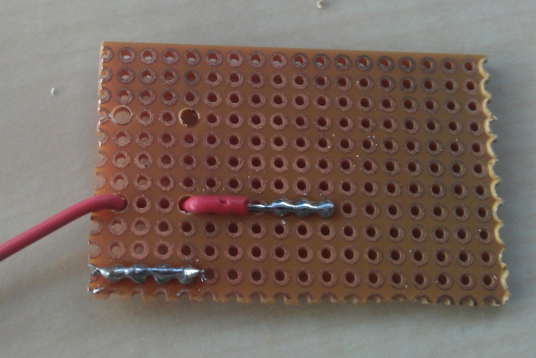
Connecting the Jack

Slide 34
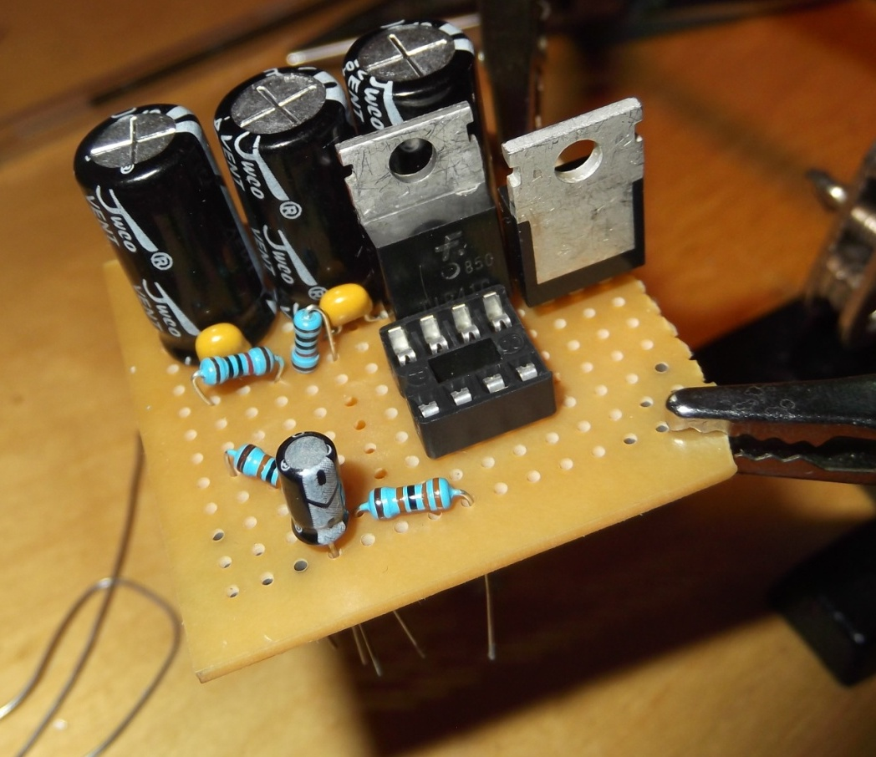
Final Product
How to get here?
Analyse the circuit diagram
Make a layout on the PCB
Insert the components and
solder them

Slide 35
Final Product
Taking the schematic and placing the components on the PCB is very time consuming
This process will take (most of) the evening!
We have therefore also made a layout for you if you just want to solder!

Slide 36
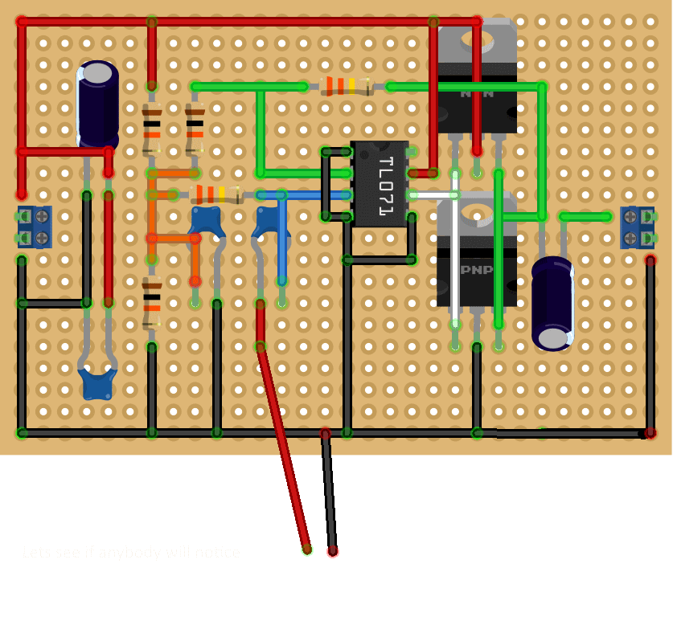
Soldering hints
Layout
  PNP & NPN
  Capacitor polarity

Slide 37

Documentation!
https://docs.scintilla.utwente.nl/masterclass/SolderingCourse2025

Slide 38
Good luck and happy soldering!
You can ask the MasterCLASS members for an example on how to solder a component. And all other questions ☺

