Slide 1
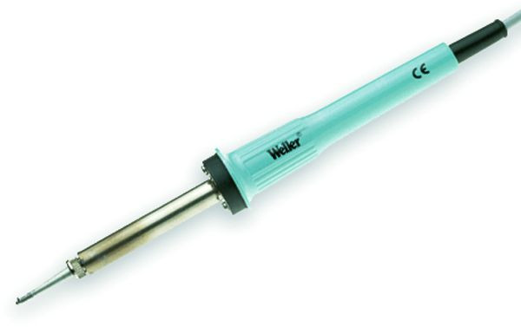
Scintilla SMD Soldering Course
March 10th

Slide 2
Planning
Lecture
Practical
What is (SMD) soldering?
Electronic components
Soldering techniques
Principles of the kit
Soldering the components
Testing
Debugging
Testing
Etc.

Slide 3
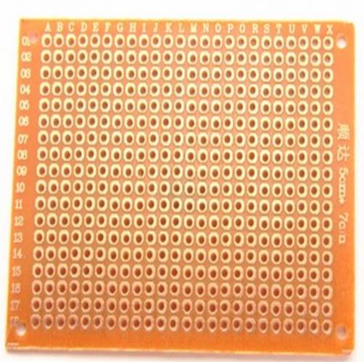
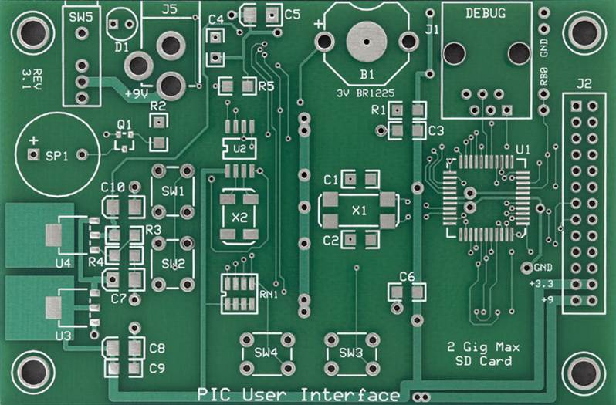
What is soldering?
Through-hole (THT)
Surface mount (SMD)

Slide 4
Electronic Components
What to take into account?

Slide 5
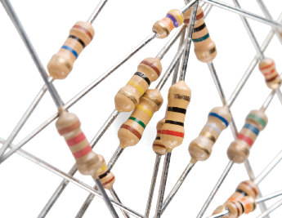
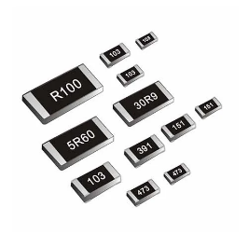
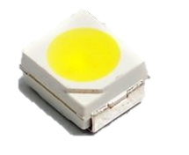
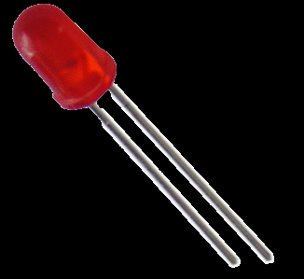
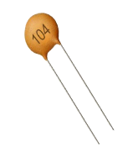
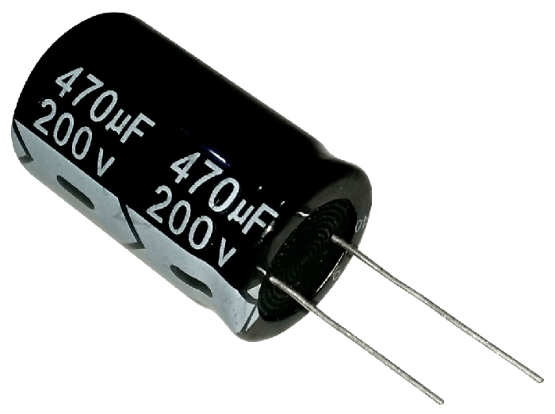
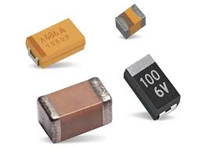
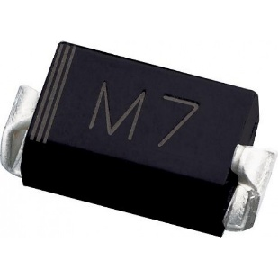

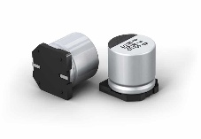
SMD components

Slide 6
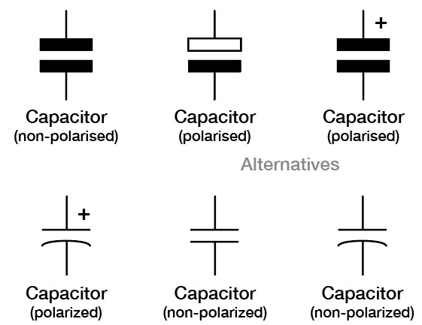


Capacitors

Slide 7
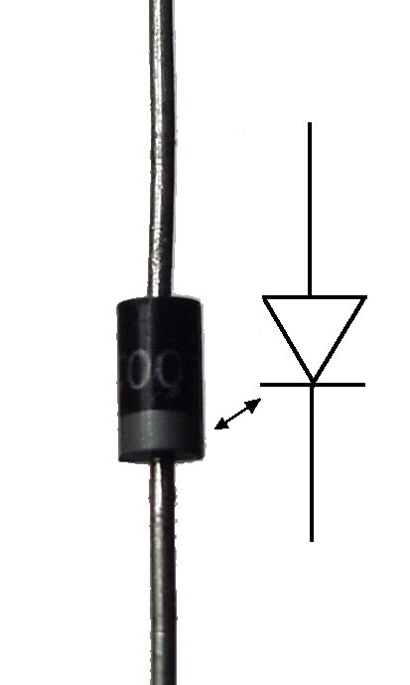
Polarized Components
Only possible to connect in 1 direction
+
+
For through hole:
Long side usually ‘+’
White stripe usually ‘-’
For SMD Look on the PCB
Usually says on the PCB
Look for indents or marks on the components
-
-
+
-

Slide 8
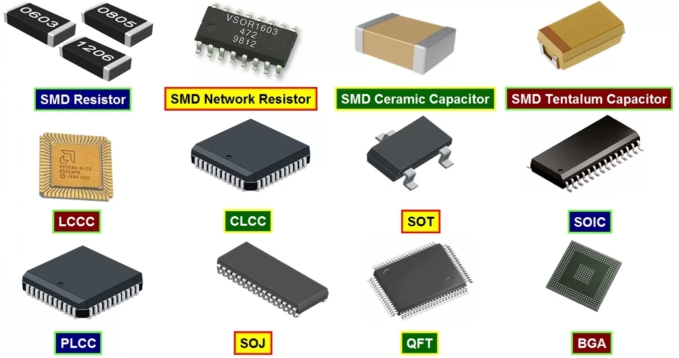

Help it has more pins!?
Orientation
Almost always a indent
Dot on the silkscreen

Slide 9
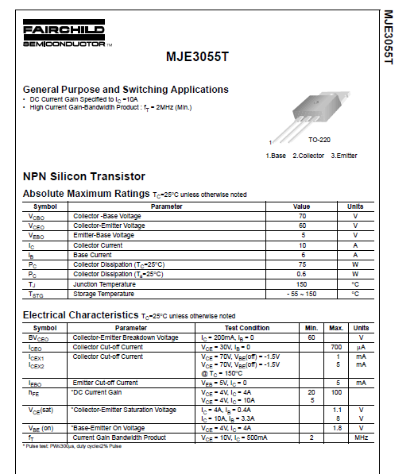
Reading Datasheets
What can you find?
Maximum ratings
Common applications
Electrical characteristics
Pin layout(!)
Look for the indent on the package

Slide 10
Soldering techniques
Do’s and don’ts

Slide 11
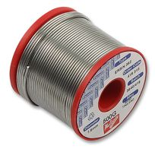
Materials
Unleaded solder ~330°C
Has an expiration date
Uses flux core
Leaded solder ~230°C
Higher melting point
Toxic fumes
Easier to solder
Uses flux core
Flux
‘Repairs’ oxidized metals

Slide 12
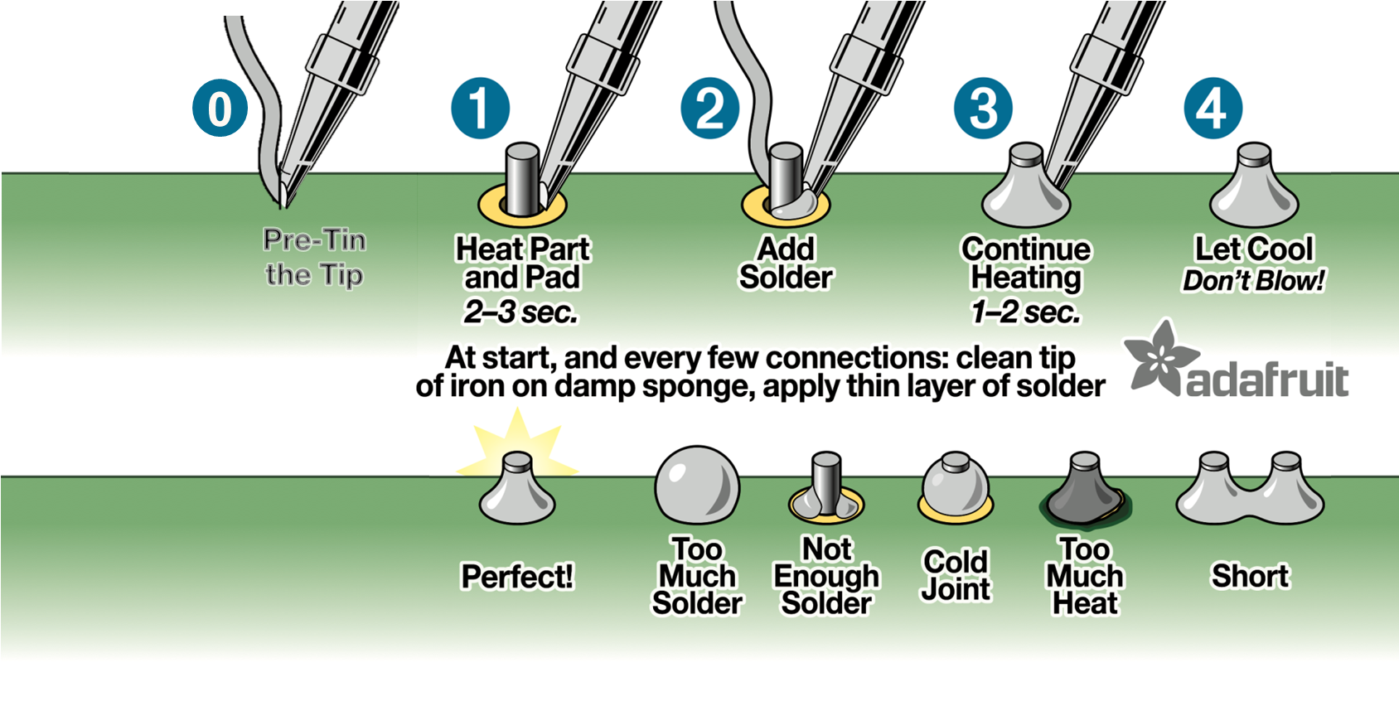
How to do it correctly
2025-04-01

Slide 13
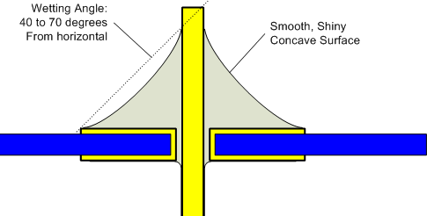
Correct Joint (THT)

Slide 14
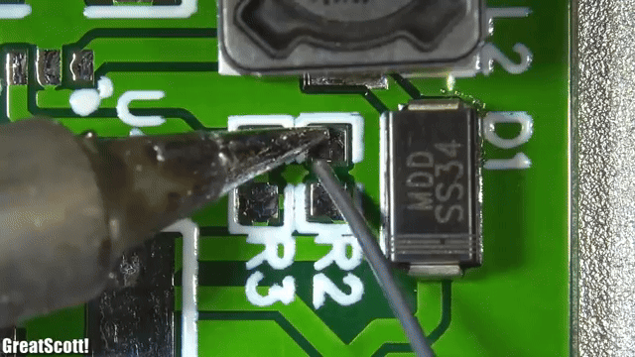
SMD soldering
First put solder on one pad
Place component
Heat first pad, then second pad and to finish again the first pad

Slide 15
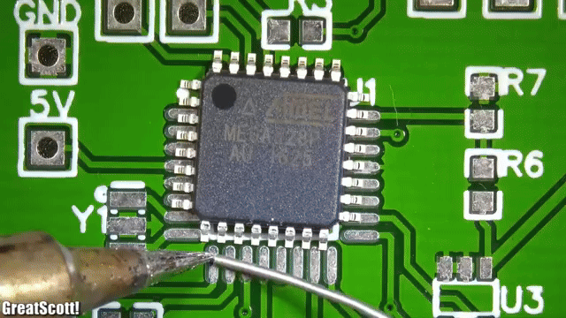
QFP chip
First attach corners
Dragging and cleaning up can be a way to do things

Slide 16
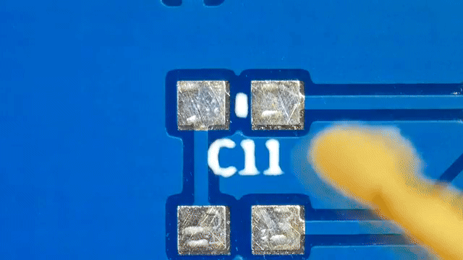
SMD soldering
Extra flux can go a long way to help, it helps to prevent oxidation and help with flowing of the solder
Good example of using too much solder

Slide 17
Start small
Use tweezers to place the components.
Start with large resistors and the small capacitors
Then work on the ic’s and led’s
Save the tall and through hole components until last!

Slide 18
Go bigger
Use the techniques to solder the bigger components (mostly chips).
Think smart about which one to place first.
Picture of bigger components on PCB

Slide 19
Go through
Finish with the through hole components.
Watch out for the polarity of caps and LEDs
Foto of through hole components

Slide 20
Finding Errors
And fixing them!

Slide 21
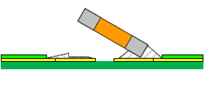
Finding errors
Visual inspection
Common errors:
Missing connections
Short circuits
Cold joints
Dry joints
Tombstoning

Slide 22
Visual Inspection
Clearly not finished
Place picture of missing component
Fast and simple method to find faulty or missing connections

Slide 23
Continuity measurement
Are all components connected?
Place picture of bad soldered connection

Slide 24

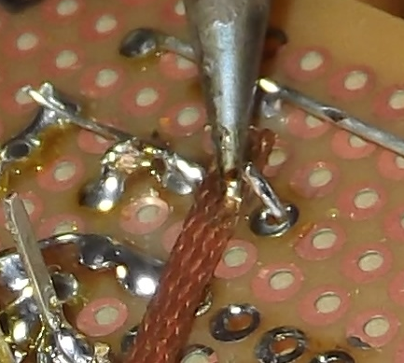
Fixing errors
Flux
Desoldering Wick

Slide 25
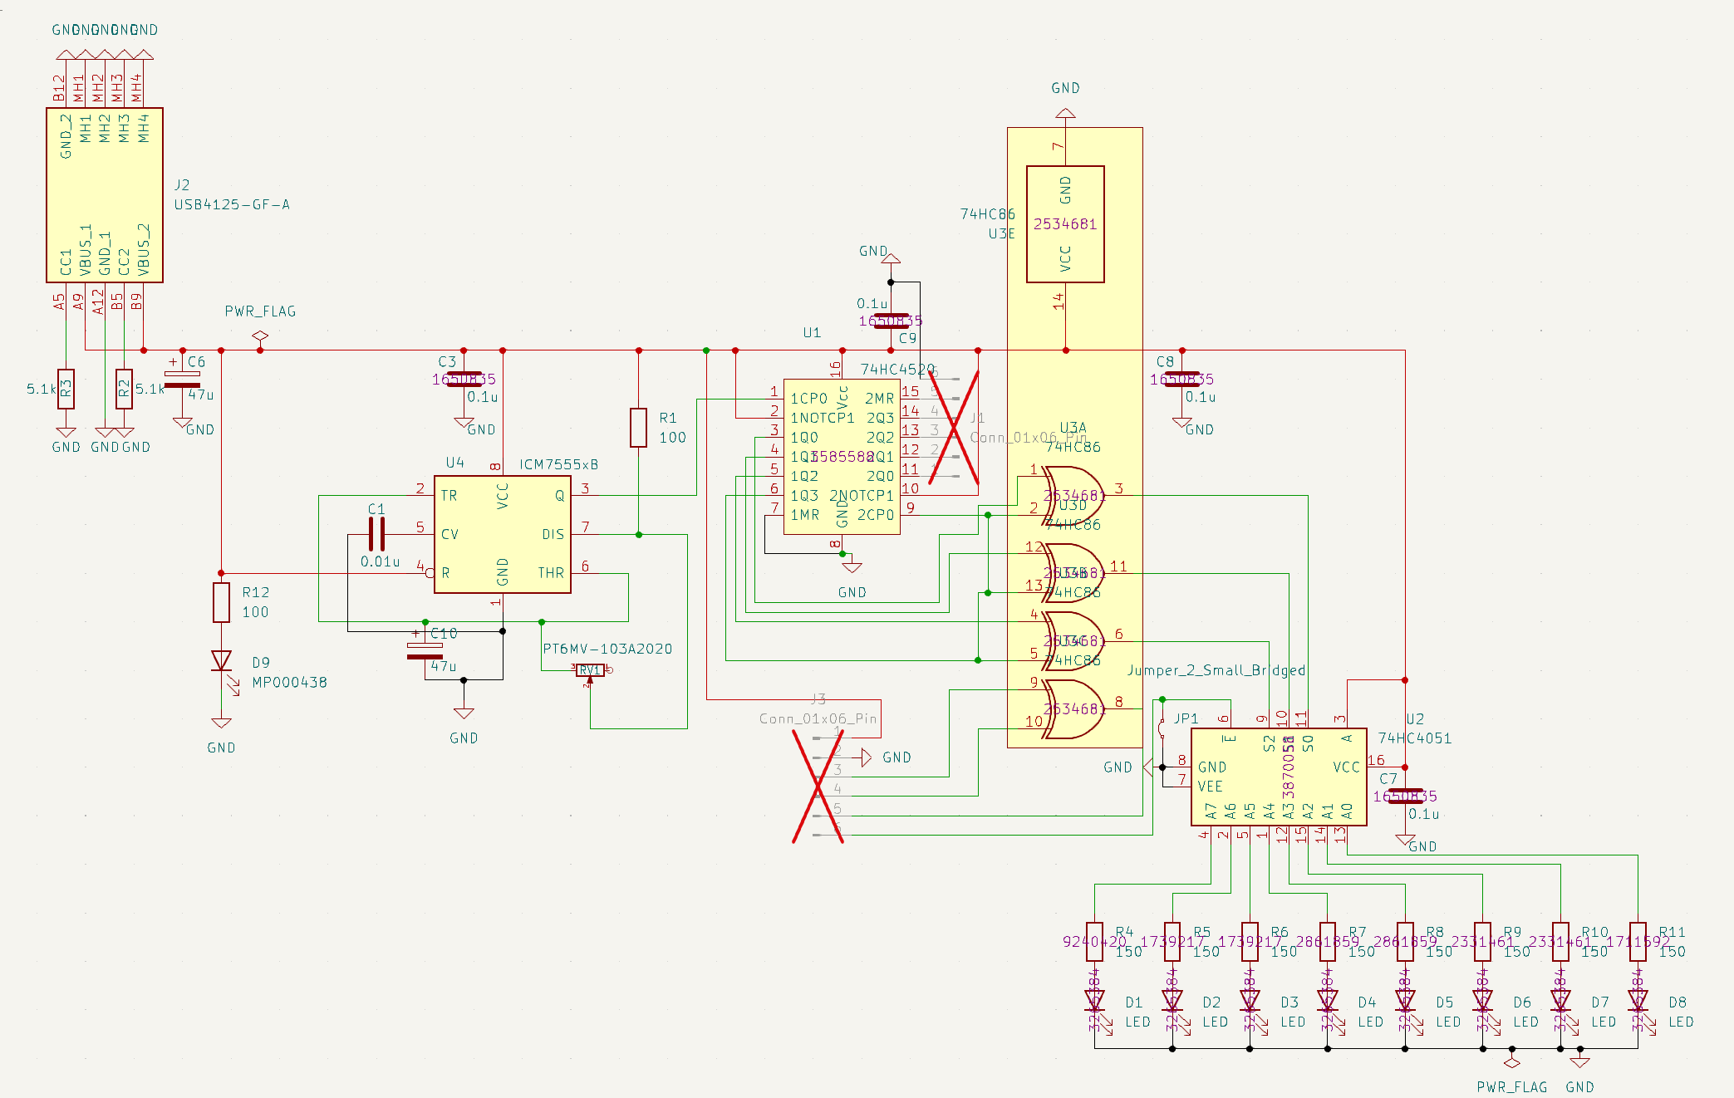
Principals of the circuit

Slide 26
Principals of the circuit
USB
XORs
Demultiplexer
Timer
Counter
LEDs

Slide 27
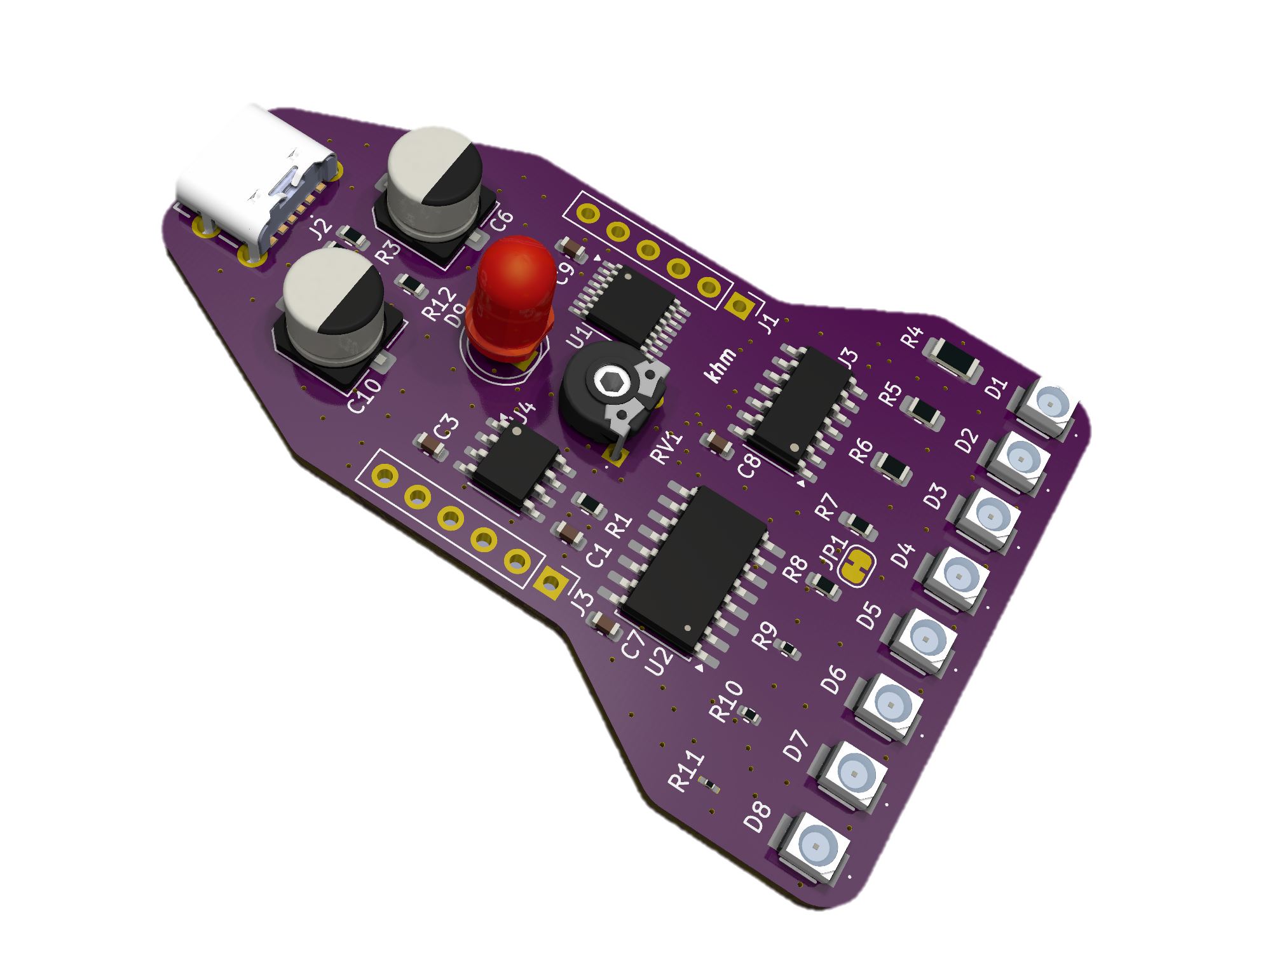
Principals of the circuit

Slide 28
Good luck and happy soldering!
You can ask the MasterCLASS members for an example on how to solder a component. And all other questions ☺

