Slide 1
Scintilla Soldering Course
15 & 16 October 2018

Slide 2
Who are we?
Jasper Vinkenvleugel
Marissa Jonker
Eva Plas
Wouter Nijenhuis
Lars Holm
Ewout Baars
Notes:
Namen wijzigen

Slide 3
Planning
Lecture
What is soldering
Electronic components
Soldering techniques
Finding and fixing errors
Principles of the audio amplifier
Hands on,
Planning your amplifier
Building your amplifier
Testing
Debugging
Testing
Etc.

Slide 4
1. What is Soldering?
Connecting components with solder
Permanent
Cheap
Durable

Slide 5
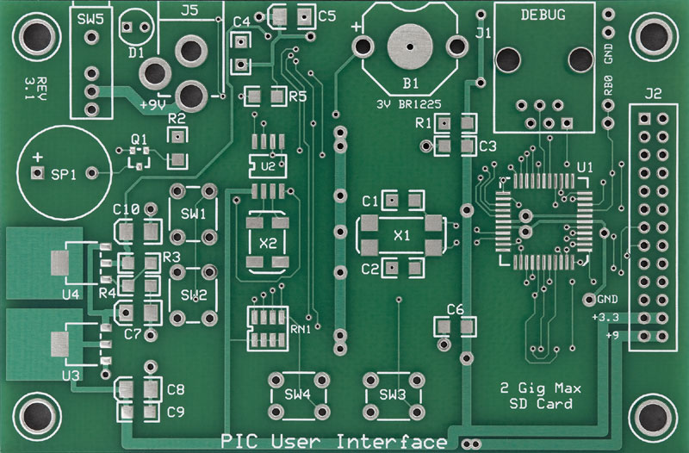
Automated Soldering

Slide 6
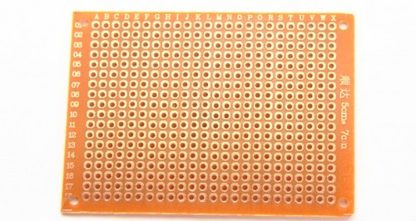
Hand Soldering

Slide 7
2. Circuit Layout
Polarity
Transistors
Reading datasheets
IC sockets
Planning your circuit

Slide 8
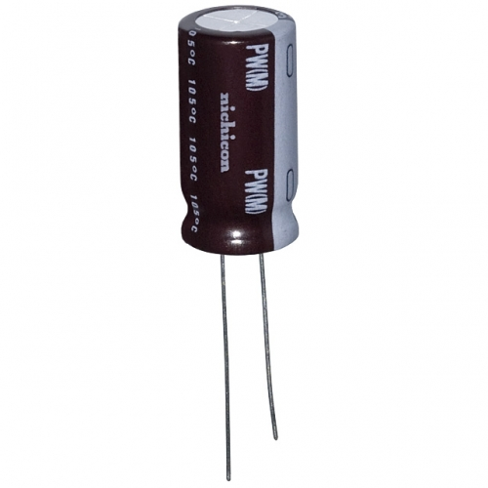
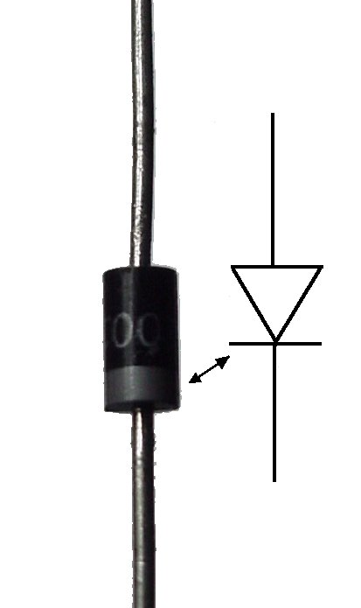
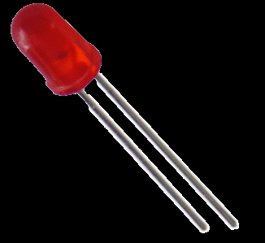
Polarity
Long side is usually “+”
+
+

Slide 9
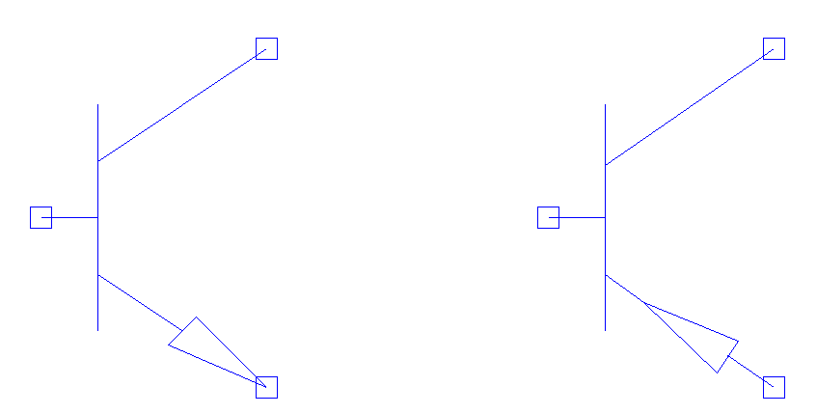
Bi-polar Junction Transistors
“Transfer Resistor”
Current amplifier with factor hfe
C
C
B
hfe
B
hfe
1
1
E
E
NPN
PNP

Slide 10
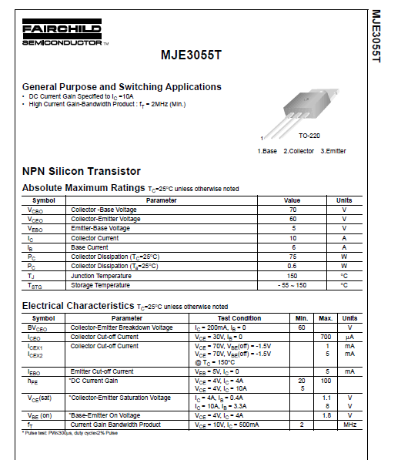
Reading Datasheets
Maximum ratings
Common applications
Electrical characteristics
Pin layout

Slide 11
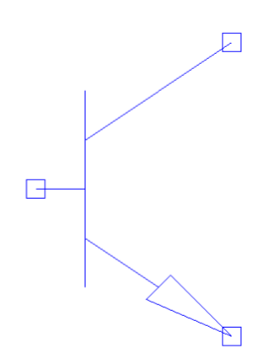
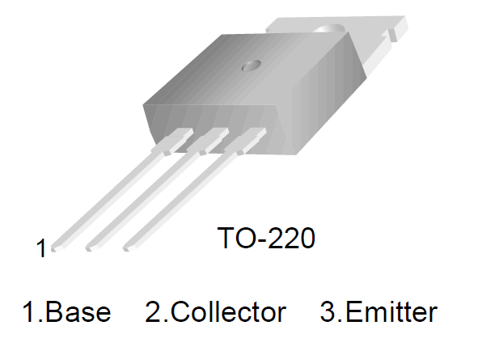
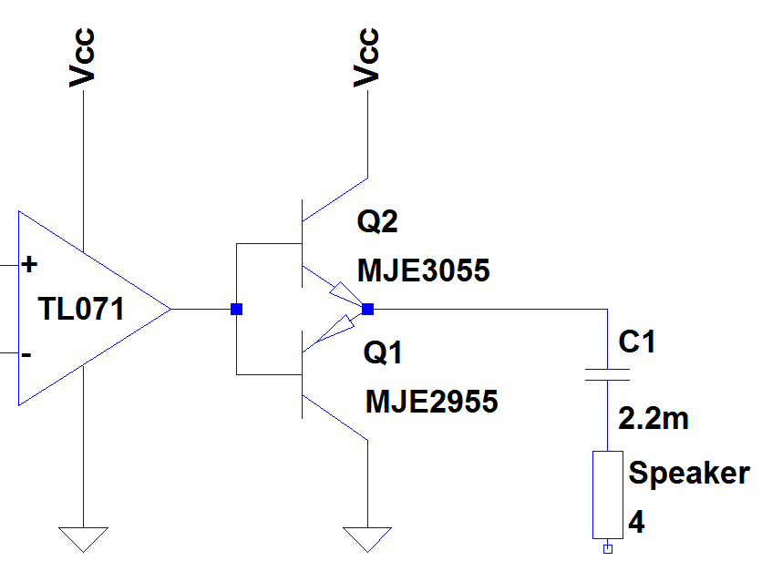
Reading Datasheets
C
B
E

Slide 12
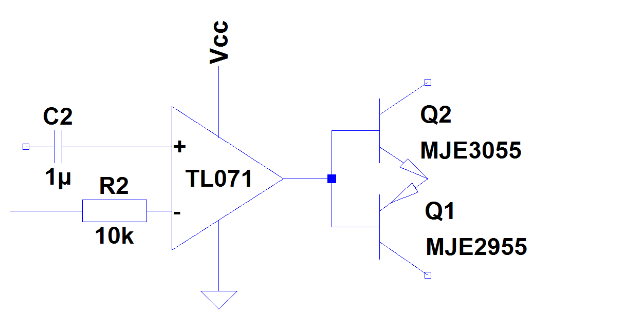
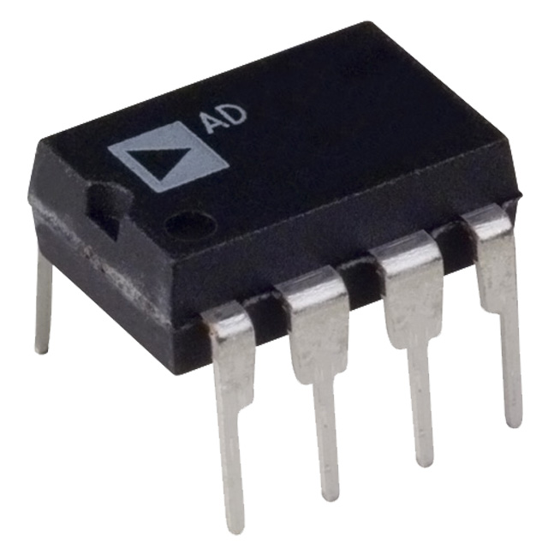
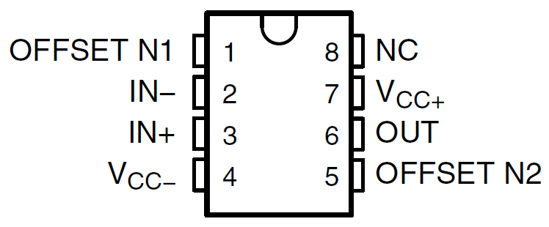
Reading Datasheets

Slide 13
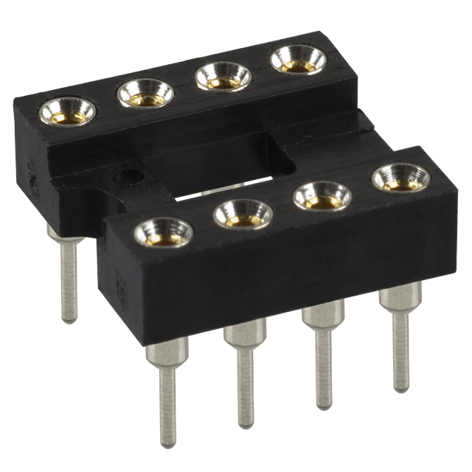
IC Sockets
Easy to replace components
Prevent overheating during soldering.

Slide 14
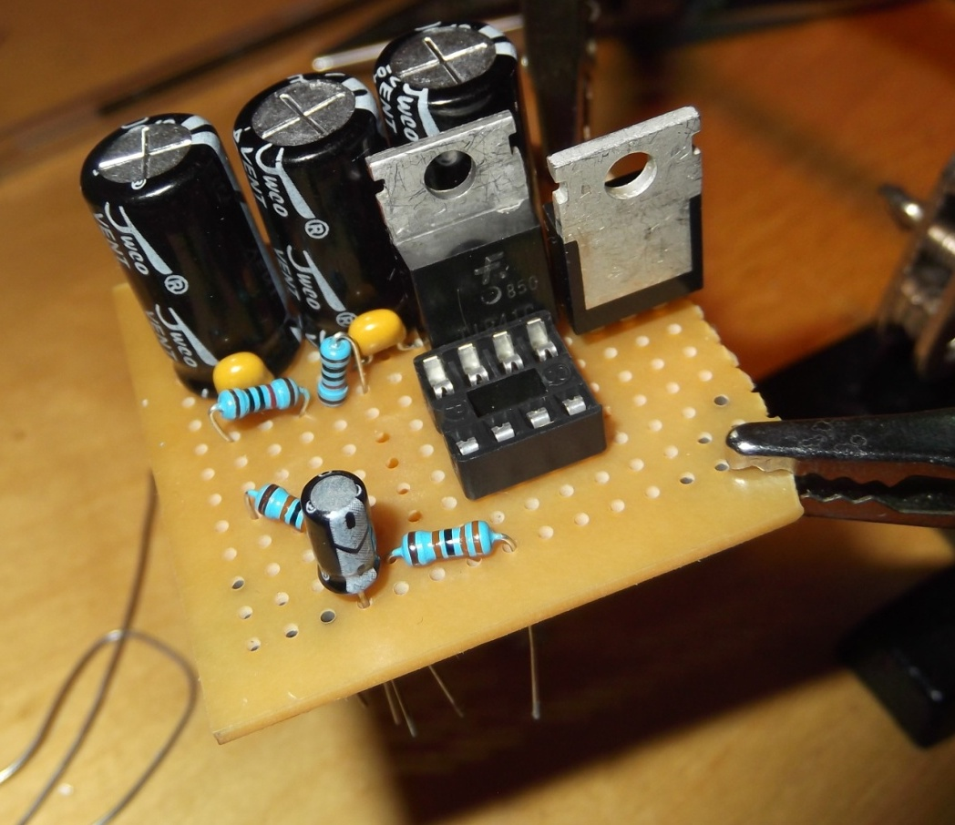
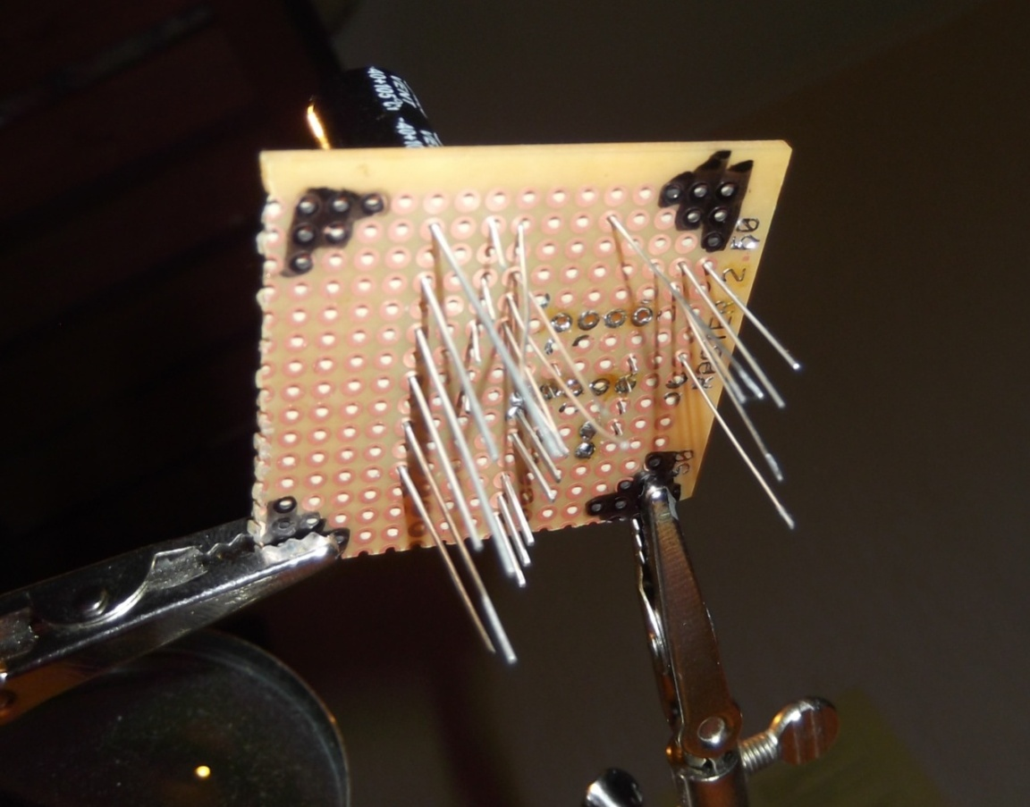
Planning your circuit
Lines or points for common connections
Try to fit your layout on your print

Slide 15
3. Soldering Techniques
Sorts of tin
Trough-hole print
Interconnections
Soft core wires
External connections
Jack plug

Slide 16
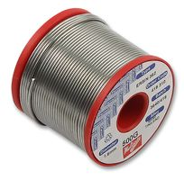
Sorts of tin
Lead
Unleaded solder ~220°C
Flux
Repairs oxidized metals

Slide 17
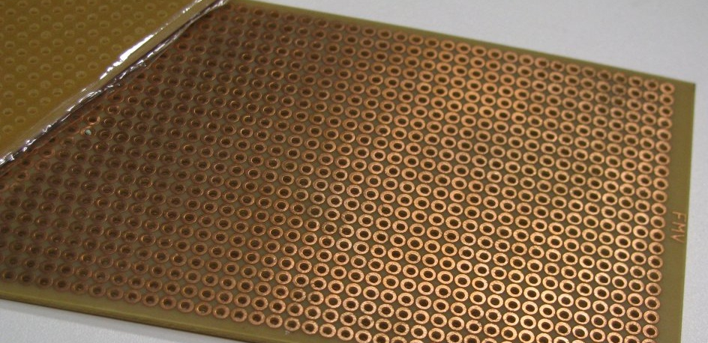
Trough-hole print

Slide 18
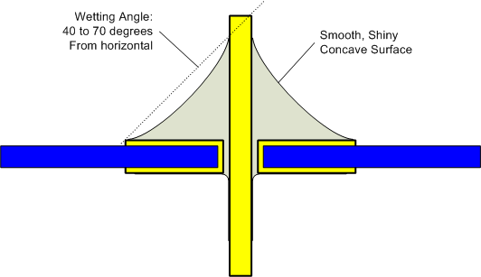
Correct joint

Slide 19
Interconnections
Component legs
Solder bridges ← Advised
Wire bridges

Slide 20
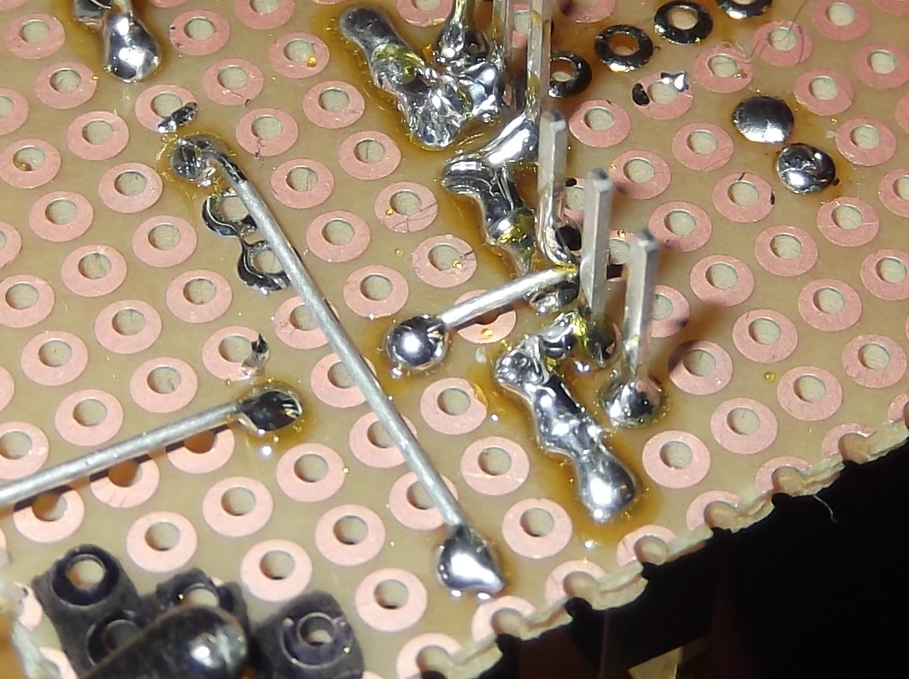

Slide 22
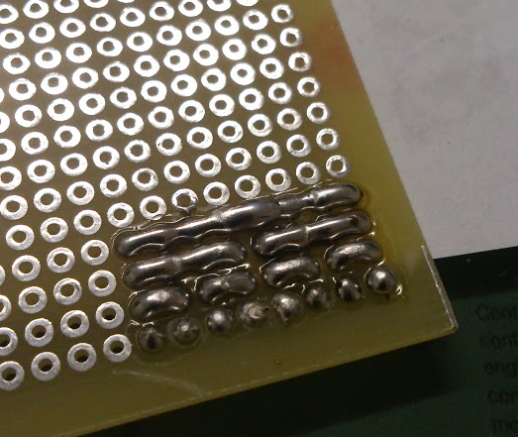

Slide 23
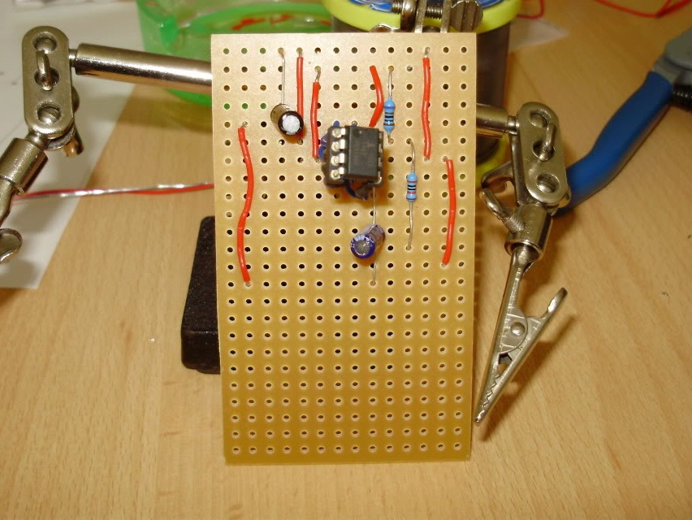
Very BAD example!!!

Slide 24
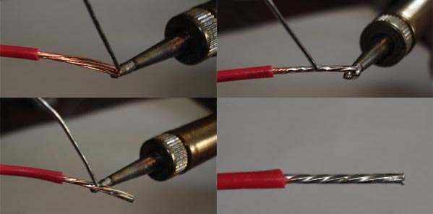
Soft core wires

Slide 25
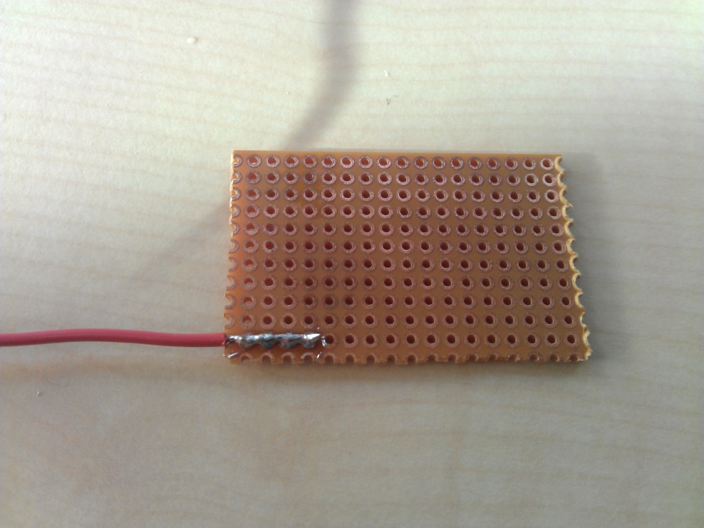
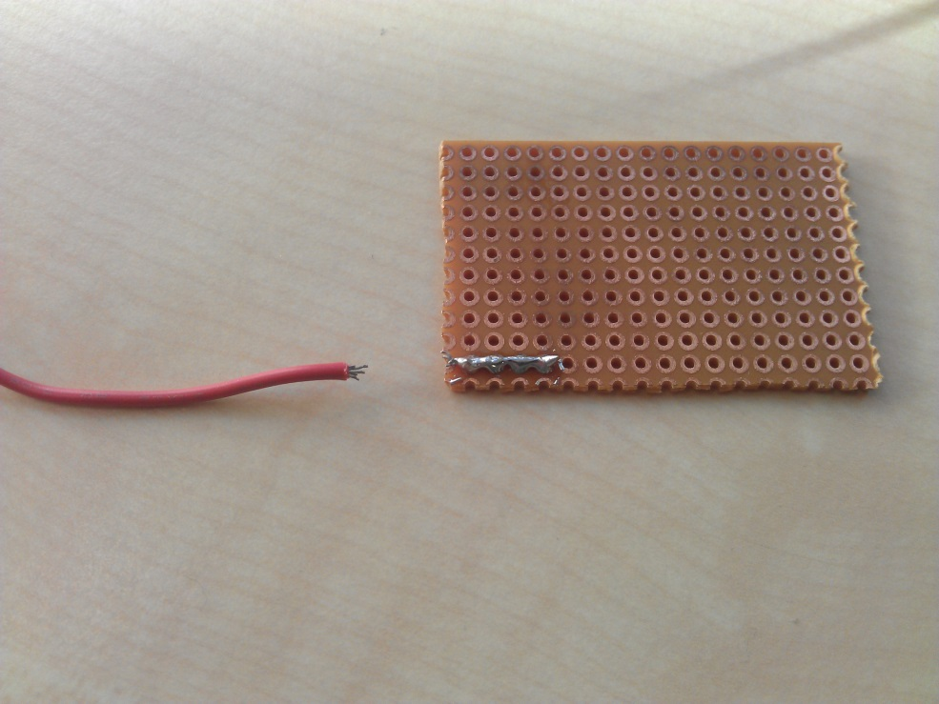
External connections
Electrical AND mechanical characteristics are important!

Slide 26
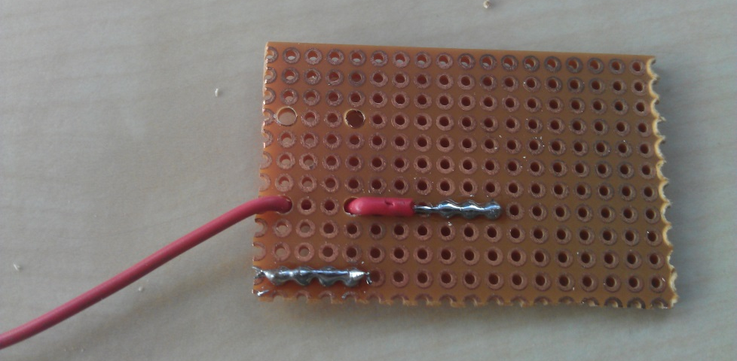
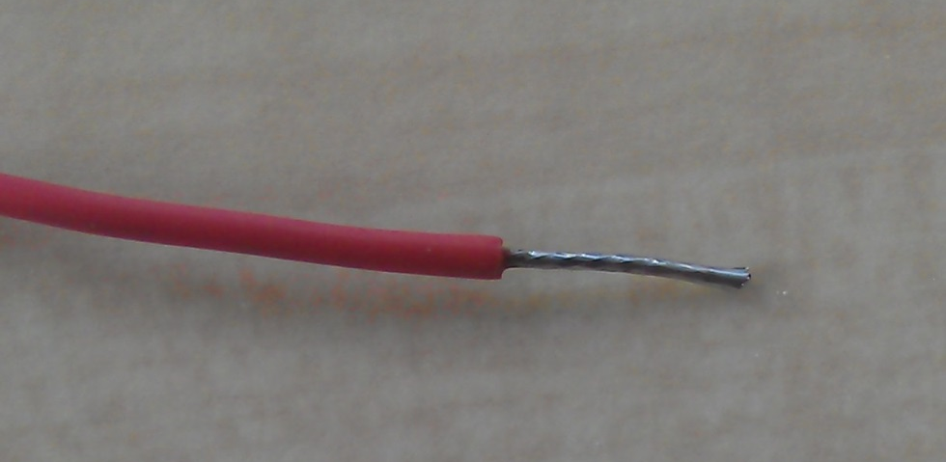
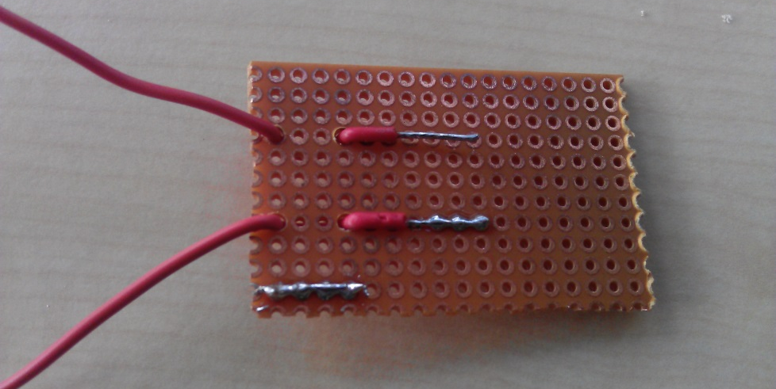
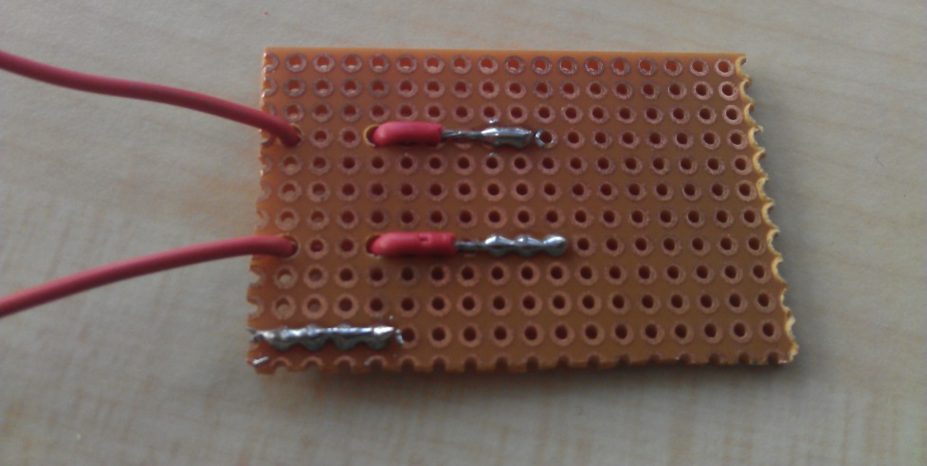
External connections

Slide 27
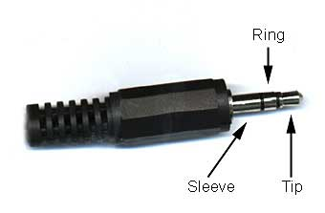
Jack plugs
Right channel
Mono amplifiers only use the left channel
Ground
Left channel

Slide 28
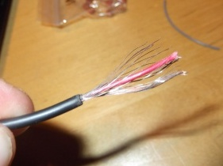
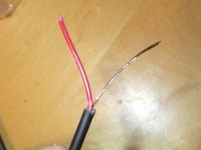
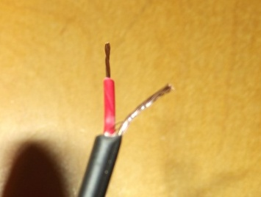
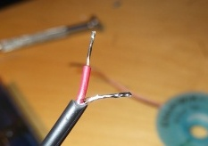

Slide 29
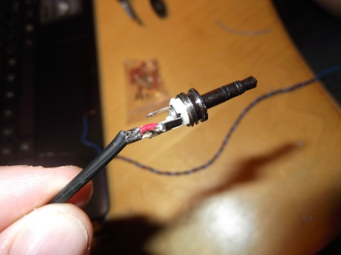
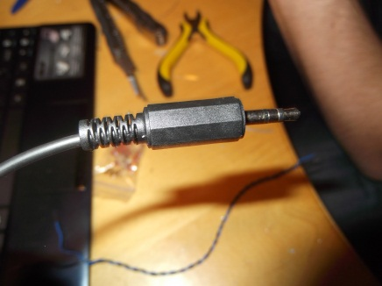
Jack Plugs

Slide 30
4. Finding and fixing errors
Common errors
Finding errors
Fixing errors

Slide 31
Common errors
Missing connections
Short circuits
Cold joints
Dry joints

Slide 32
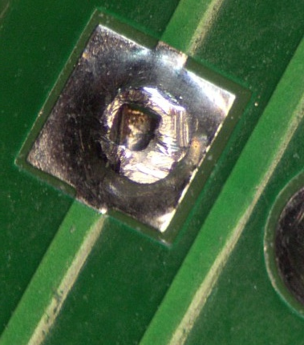
Cold joint
Cause: cold metal
Solution: reheat

Slide 33
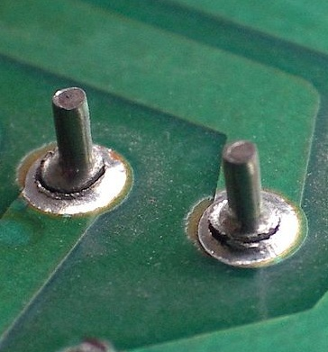
Dry joint
Cause: movement during cooling
Solution: reheat

Slide 34
Finding errors
Visual inspection
Voltage measurements at critical points
Tracing the signal

Slide 35
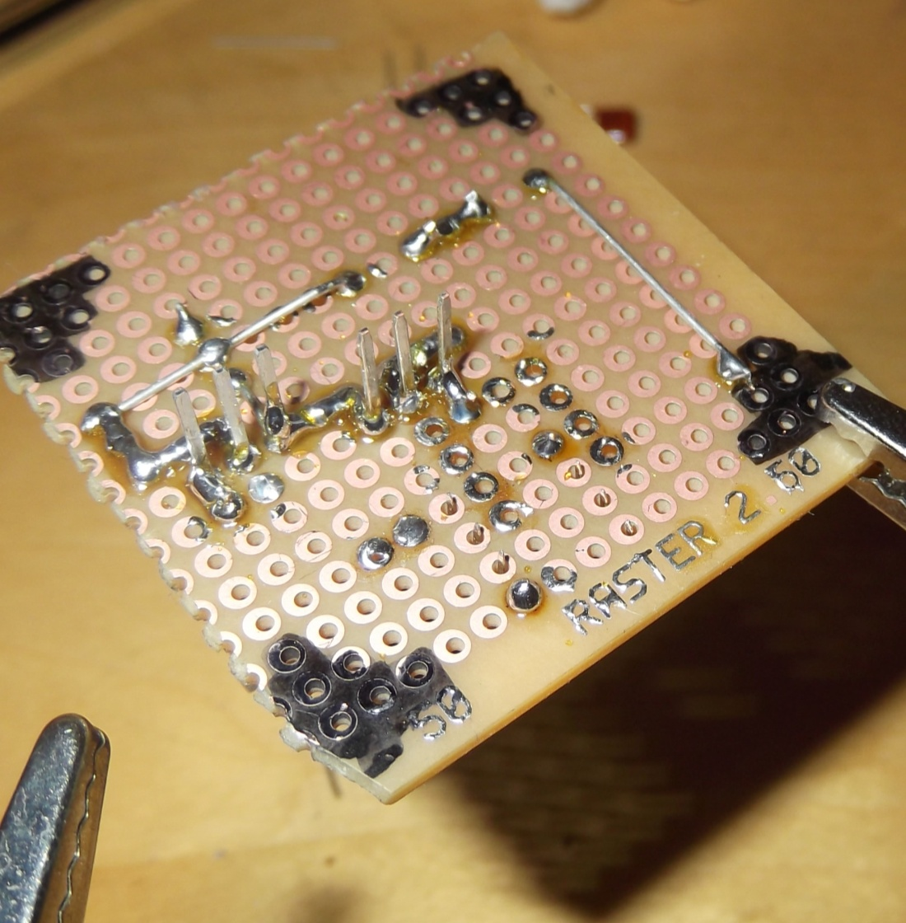
Visual inspection
Fast and simple method to find faulty or missing connections
Clearly not finished

Slide 36
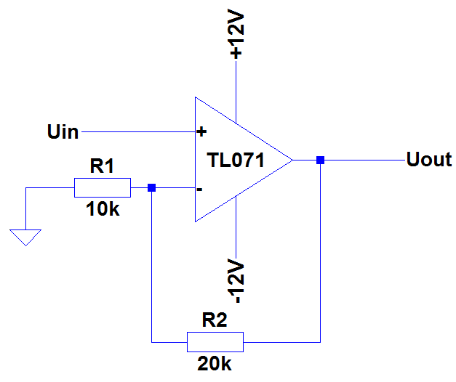
Tracing the signal/voltage measurement
What voltages/signals do you expect at every node?

Slide 37
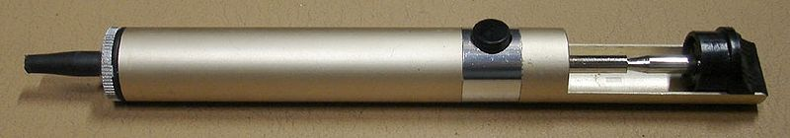
Fixing errors
Place missing connections
Resolder bad joints
Remove excessive tin
Desoldering pump
Desoldering wick

Slide 38
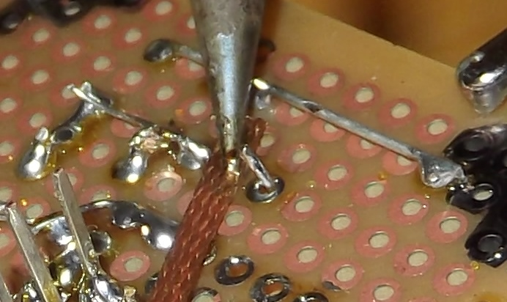
Desoldering wick

Slide 39
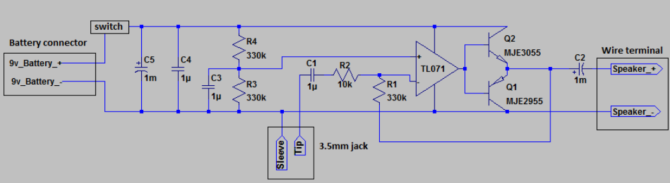
5.The practicum

Slide 40
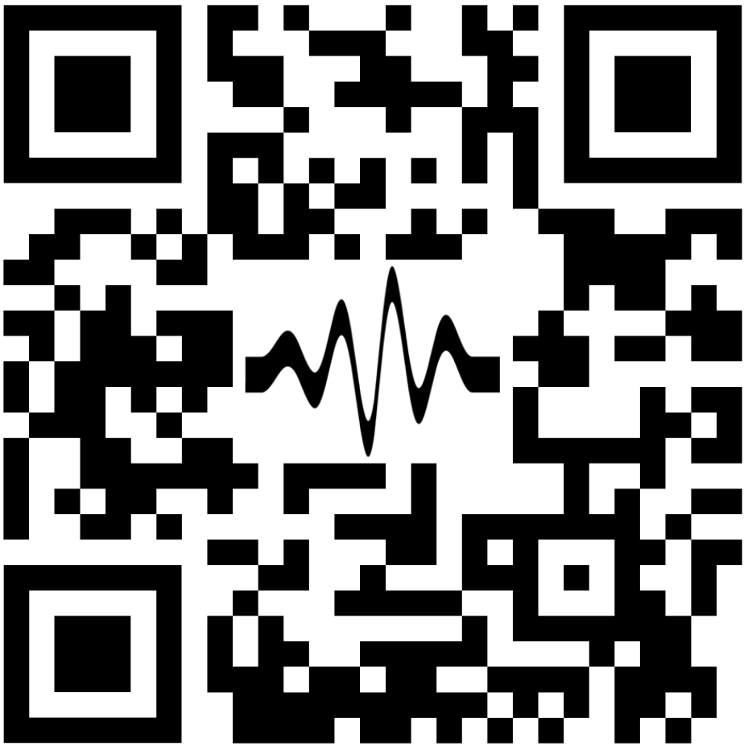
5.The practicum

Slide 41
The practicum
Rules
No eating or drinking in the Westzaal
Building is locked, ask us to let you out
Soldering irons down at 22:30

Slide 42
The Practicum
Questions?

